Slide 1


Resembling COVID-19
Using Generative Adversarial Networks (GAN’s) to create CT-Scans of COVID-19 infected lungs
Dieter Hoogestraat, Felix Facklam, Ali Farooq @opencampus Tensorflow SoSe2020

Slide 2
Agenda
Goal
Generative Adversarial Network (GAN)
Data
Methods
Results
Conclusion & Future Work

Slide 3
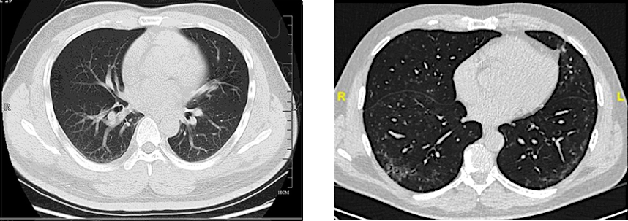
Goal
Small open source datasets with 356 COVID-19 lung CTs
Create new COVID-19 lung CTs images by using Generative Adversarial Network
Fig. 1: CT of a lung affected by COVID-19 (left), CT of a healthy lung (right)

Slide 4
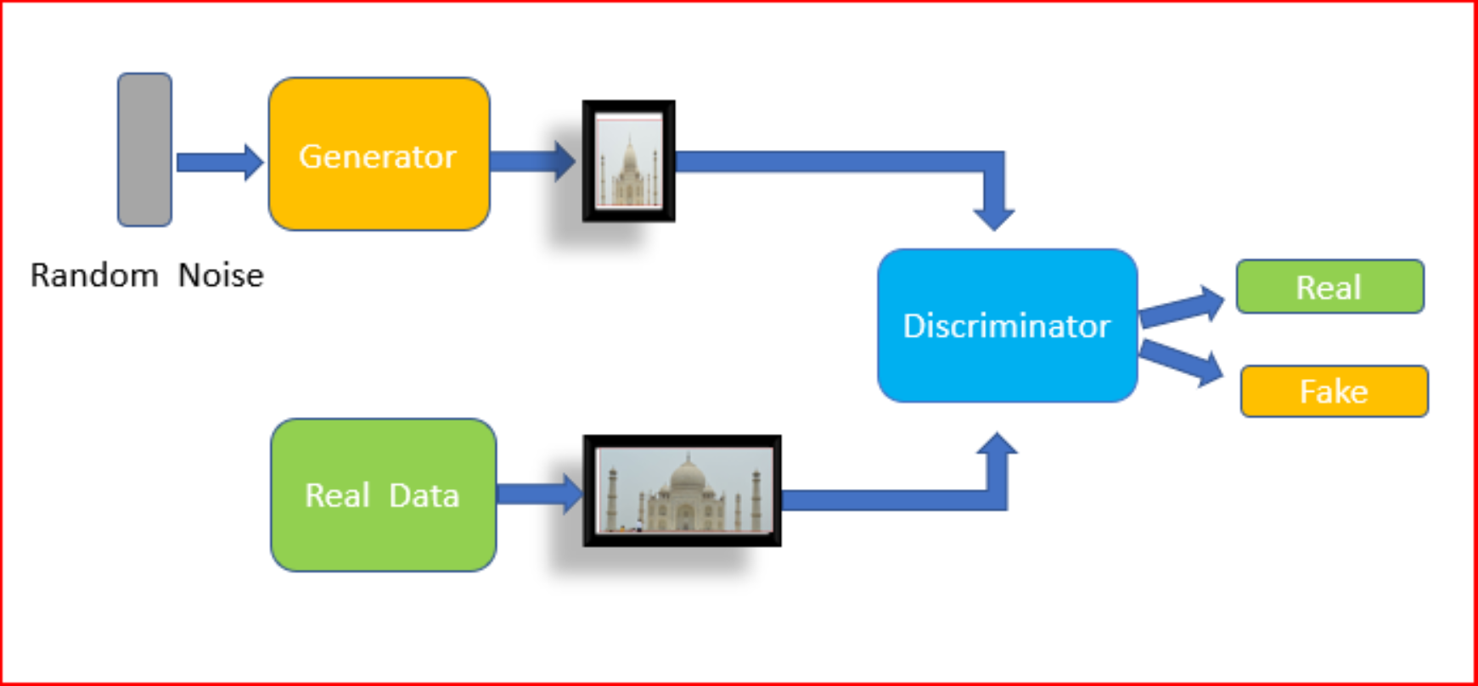
Generative Adversarial Networks (GAN’s)
Two competing deep neural networks
Generator (Image generator)
Discriminator (Classifier)
Networks trying to optimize itself
Generator can learn any data distribution
Fig. 2: Structure of a Generative Adversarial Network (GAN)
Notes:
Generator uses gradient of discriminator to train (Backpropagation)
Generating images which resemble images from the datasource and by that creating new images
Generator uses random noise to create images. Does NOT use Real Images
Discriminator classifies images in 2 categories: Real image, fake image (from generator)
Discriminator trained in standard supervised learning way
Both networks try optimize itself
Generator can learn to mimic any distribution of data
Image source: https://medium.com/datadriveninvestor/generative-adversarial-network-gan-using-keras-ce1c05cfdfd3

Slide 5
Data
750 CT scans, 316 with COVID-19 https://www.kaggle.com/luisblanche/covidct
40 CT scans with COVID-19 from https://ieee8023/covid-chestxray-dataset
easily readable image formats
different sizes/resolutions
some with additional image-element (e.g. x-ray), that had to removed -> 356 CT scans as input for a GAN
Meanwhile there are more CT-datasets available. For this task and with respect to the available resources, the GAN input was restricted to these scan.

Slide 6
Methods
Starting point: https://www.tensorflow.org/tutorials/generative/dcgan (as a blueprint)
Write some code to get the CT scans
Different parameters were test to produce better results such as:
Testing activation functions (Relu, LeakyRelu) -> LeakyRelu (slide 7)
No. of hidden layers for generator and discriminator (11/8)
Testing learning rates: 1E-3 to 1E-5 -> 1E-4 turned out to be the best choice
Testing for dropout/no dropout: no dropout
Epochs: as much as possible
Batch size: depending on resources (as by now)
Notes:
Discriminator layer: 3 Conv + 3 Activations + 1 Dense + 1 Flatten = 8
Generator layer: 3 Conv + 3 Activations + 3 Normalisations + 1 Reshape + 1 Dense = 11

Slide 7
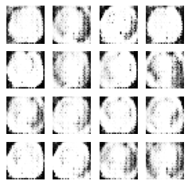
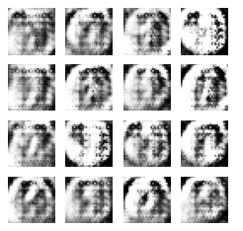
Results
500 epochs, learning rate 1E-4, resolution 28x28
ReLu LeakyReLu
Fig. 3: Results after 500 epochs with ReLu activation function (left) and LeakyRelu activation function (right)

Slide 8
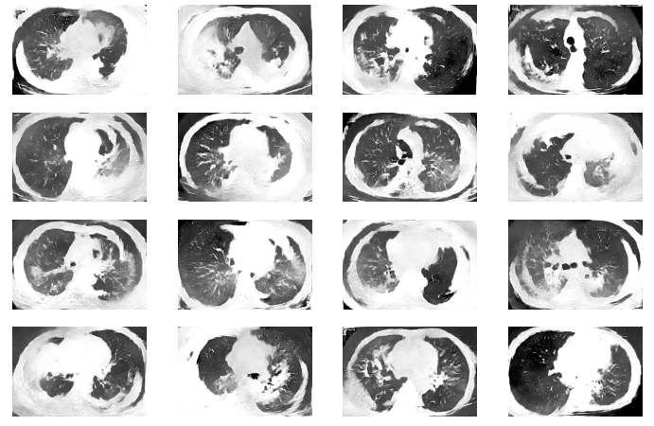
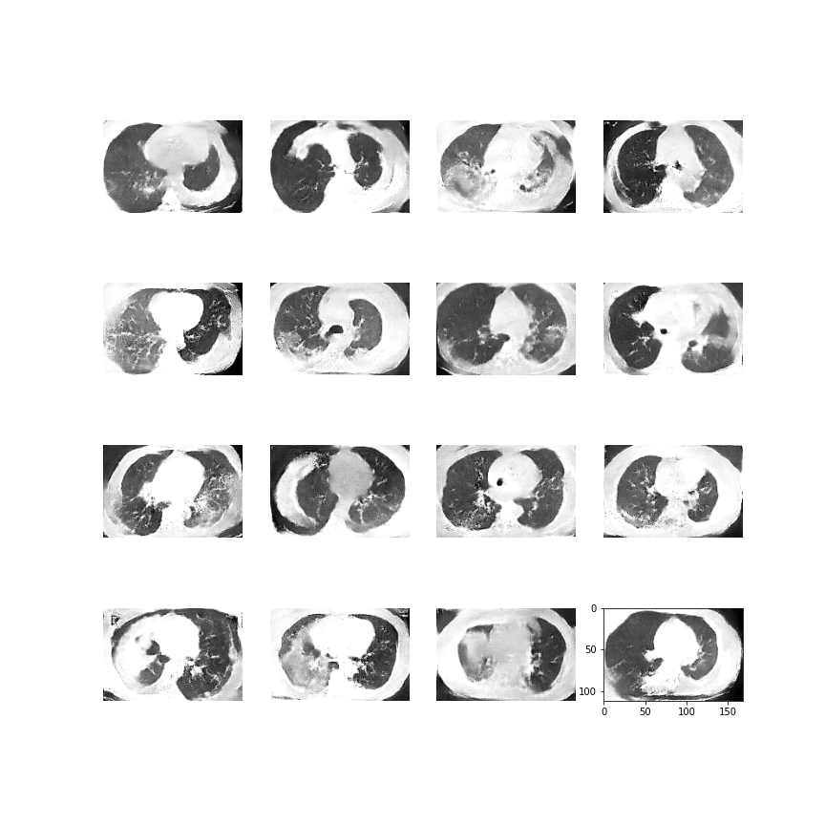
Results
learning rate 1E-4, resolution 336x504, no dropout
2250 epochs 1000 epochs
Fig. 4: Results after 1000 (left) and 2250 (right) epochs
Notes:
every pixel counts
lungs are no conecpts like letter or numbers

Slide 9
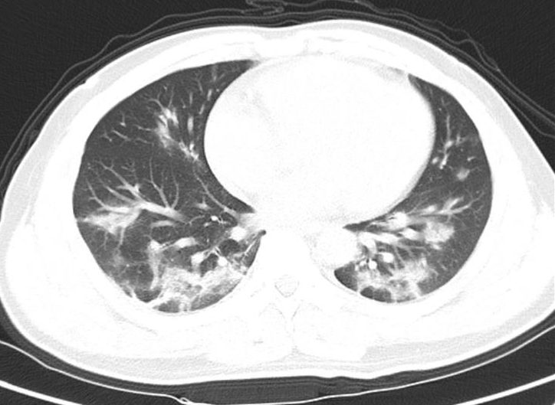
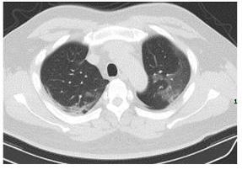
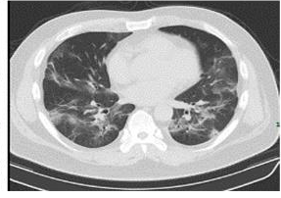
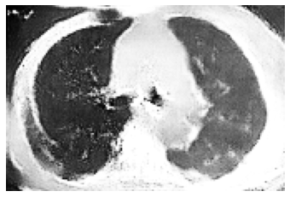
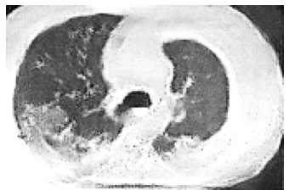
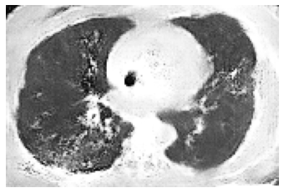
Comparison real to GAN-generated images
Real
Fig. 5:Real (top) and fake (bottom) lung CT scans
GAN

Slide 10
Results

Slide 11
Conclusion and Future Work
Created new CT Scans
Better results through:
larger dataset
more computational resources
Easily extensible code
Generated images can be used for future covid-19 projects
Notes:
obtain better results through:
Small dataset -> To cover more scenarios we need more data, many features are hidden from us
limited resources -> Colab terminates when we use too many epochs or too high resolution
Code can be easily extended to work with a larger dataset

